Slide 1
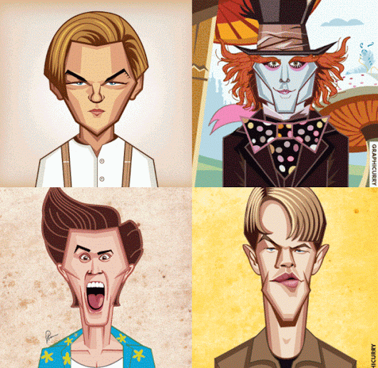
Is he a teacher?

Slide 2
Get 10 stamps
Choose 1 thing from Evolution Zone(進化區).
Choose 1thing from Movement Zone(招式區).
Choose what( ) you want.

Slide 4
a cook

Slide 5
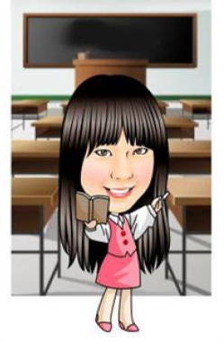
a teacher

Slide 6
a student

Slide 7
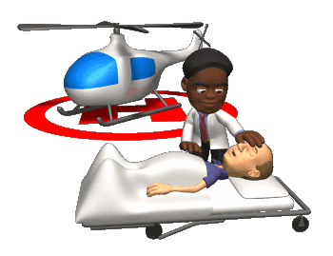
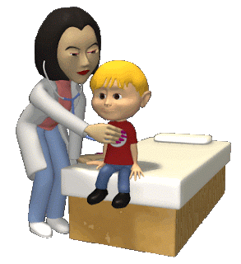
a doctor

Slide 8
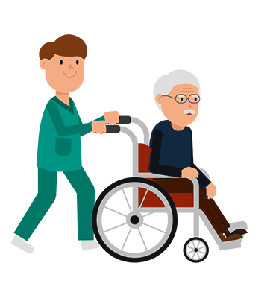
a nurse

Slide 9
a cook
a teacher
a student
a nurse
a doctor

Slide 11
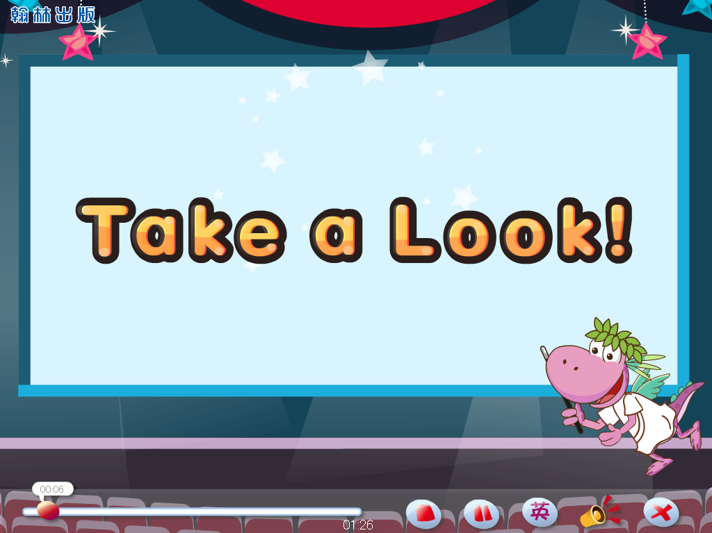

Slide 12
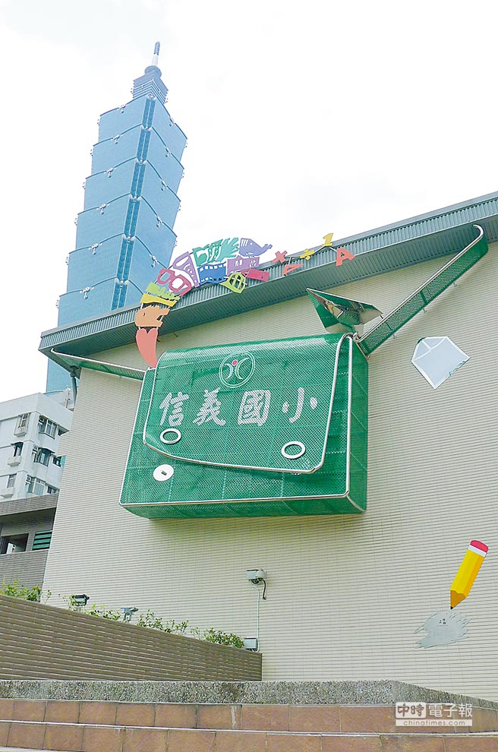
Are you a student?
Yes, I am.

Slide 13
Are you a cook?
No, I’m not.

Slide 14
Is he a teacher?
Yes, he is.

Slide 15
Is she a doctor?
No, she isn’t.

Slide 17
Are you a cook?
Yes, I am.
Is she a doctor?
No, she isn’t.
Is he a student?
Yes, he is.

Slide 18
名人Q&A

Slide 19
Is she a student?

Slide 20
Is he a cook?

Slide 21
Is she a nurse?

Slide 22
Is he a teacher?

Slide 23
Is he a student?

Slide 24
Is he a doctor?

Slide 25
Is she a cook?

Slide 26
Is he a teacher?

